Slide 1


Slide 2


INTRODUCTION
NAME- PULKIT GOEL
BRANCH- ECE
PROJECT-LED INDICATOR USING MYDAQ AND NI LABVIEW
GUIDED BY- MRS.SUVARNA MUJUMDAR

Slide 3
WHAT IS NI LABVIEW?
LabVIEW is a graphical programming environment engineers use to develop automated research, validation, and production test systems.

Slide 4
What is myDAQ ?
myDAQ is based on LabVIEW is a data acquisition and generation device that can connect virtual world to real word using LabVIEW software which give access to students and engineers to test their system before their application to real world.
It can also generate data based on our requirements.

Slide 5
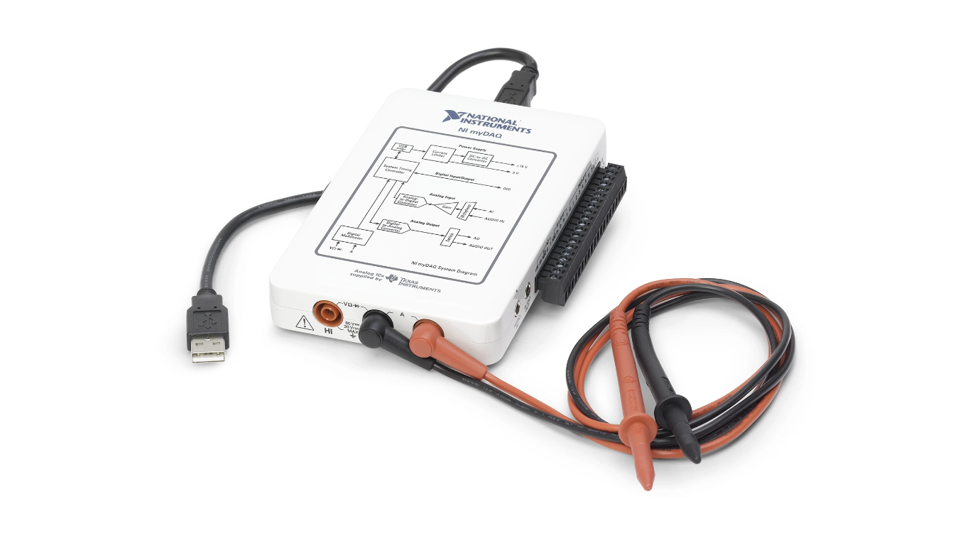

Slide 6
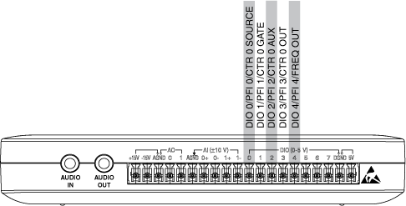
PIN DIAGRAM OF myDAQ

Slide 7
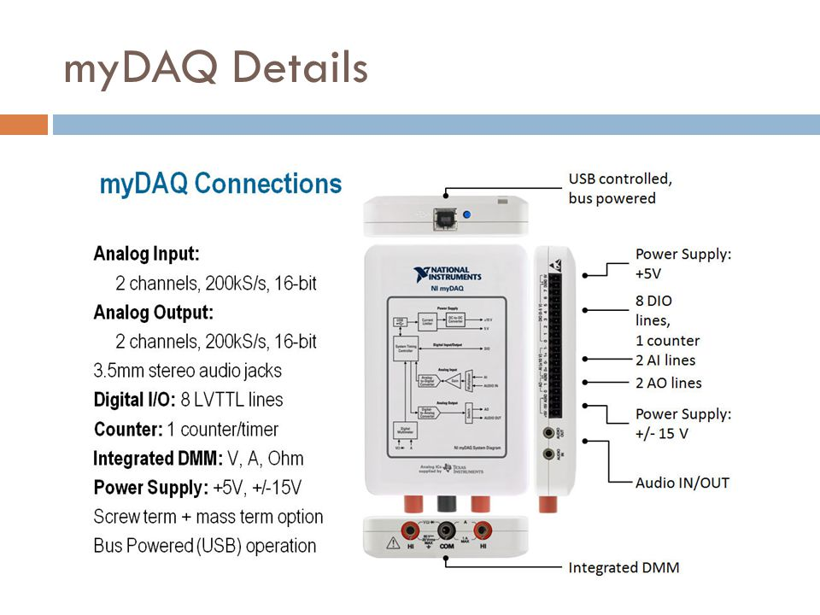

Slide 8
PROJECT- GLOWING DIFFERENT LED’S AS INDICATOR FOR DIFFERENT RANGE OF TEMPERATURE
As we know that the measuring temperature can help us in many ways as we can prevent something from burning .
So temperature measurement plays a very important role but there must be an indicator also that can help us to get the range of the temperature whether it is LOW,HIGH OR MODERATE. The temperature indicator must be as clear as water i.e. anyone can see without going through the difficult traditional method of thermometer.

Slide 9
Equipments used-
LabVIEW software
myDAQ
LEDS
Jumper wires
Breadboard
Temperature sensor
Resistors

Slide 10
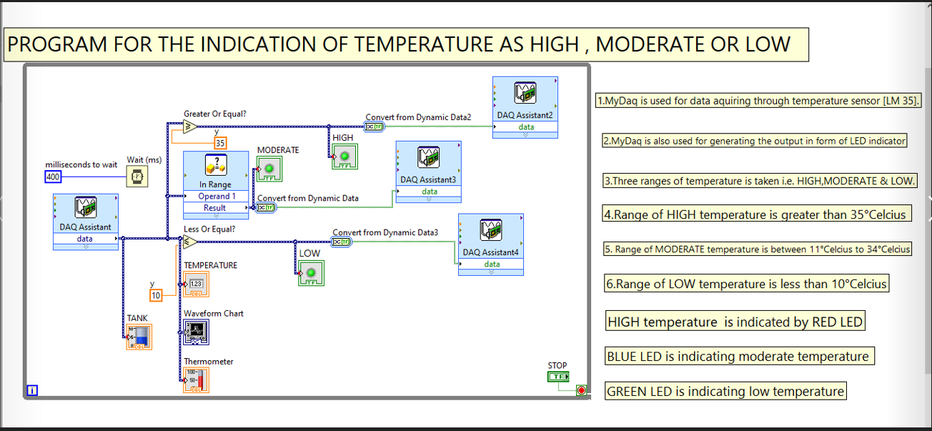

Slide 11
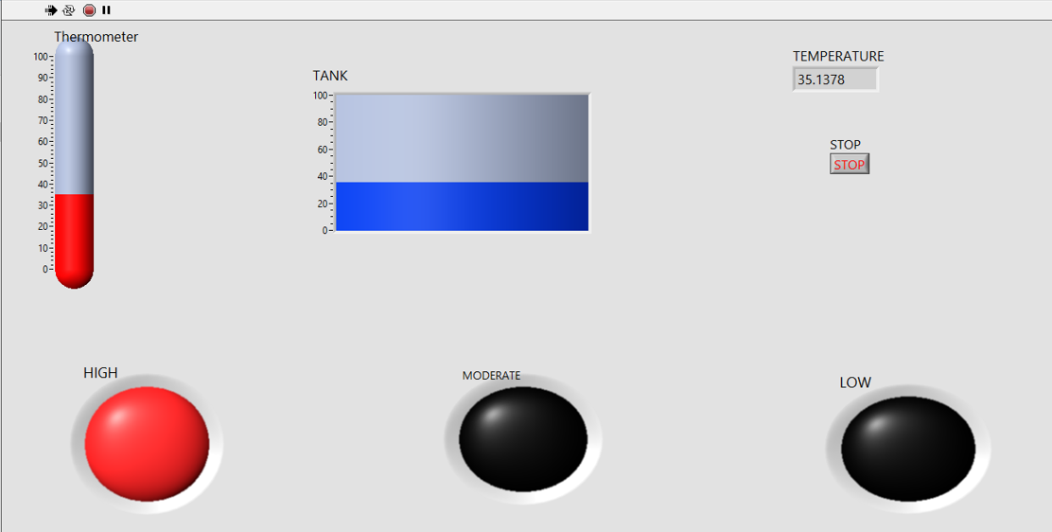
When temperature is high

Slide 12
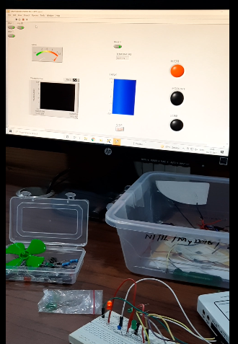

Slide 13
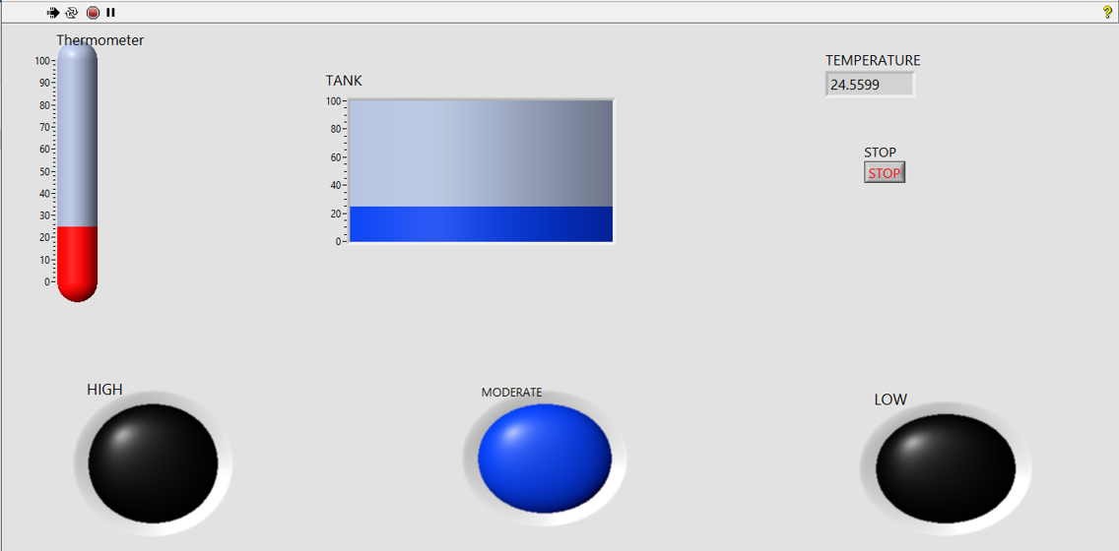
When temperature is moderate

Slide 14
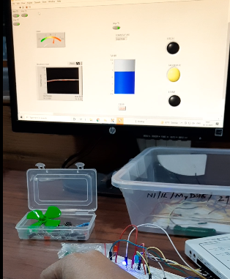

Slide 15
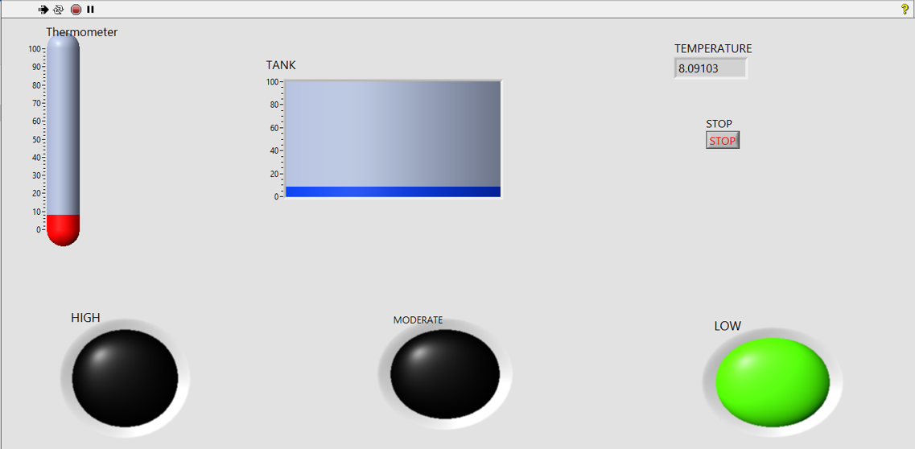
When temperature is low

Slide 16
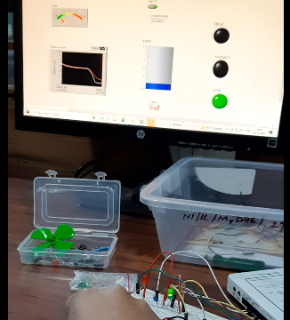

Slide 17
CONCLUSION
This will help in measuring the temperature of the surrounding area.
We can install in places where we need to measure temperature regularly.
We can also store the value of temperature in files for future references.

Slide 18
THANK YOU

